Slide 1
Database systems
Database Architecture
Faculty of AI & MMG

Slide 2
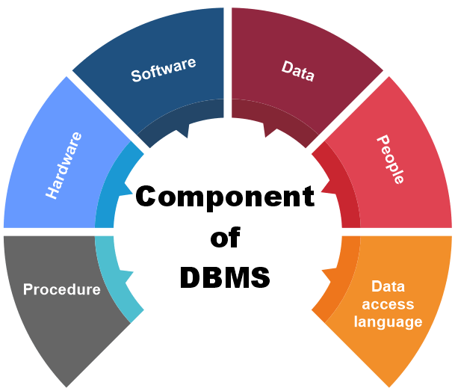
Components of Database Systems

Slide 3
Major Components of Database Systems
Procedures: Instructions and rules for database operation, maintenance, and use.
The procedure is a type of general instruction or guidelines for the use of DBMS.
Instruction includes how to set up the database, how to install the database, how to log in and log out of the database, how to manage the database, how to take a backup of the database, and how to generate the report of the database.
In DBMS, with the help of procedure, we can validate the data, control the access and reduce the traffic between the server and the clients.
Hardware: The physical devices where the database resides and operates, such as servers, storage devices, and network infrastructure.

Slide 4
Major Components of Database Systems
Software: This includes:
Database Management System (DBMS): Software responsible for managing, storing, retrieving, and manipulating data.
Application Software: Programs that interact with the database to provide user interfaces or business logic.
Operating System: Supports the DBMS and related applications.
Data: The database contains the actual data and metadata.
Here metadata means data about data.
For example, when the user stores the data in a database, some data, such as the size of the data, the name of the data, and some data related to the user, are stored within the database. These data are called metadata.

Slide 5
Major Components of Database Systems
People / Users: The people or applications interacting with the database. Users can be categorized as:
End Users: Access data directly for queries, reports, or updates.
Application Developers: Build programs to interact with the database.
Database Administrators (DBAs): Manage the database, ensuring efficiency, security, and backup.
Database Access Language: It is a language that allows users to write commands to perform the desired operations on the data that is stored in the database.
e.g. SQL

Slide 6
What is Database Architecture?
Database architecture refers to the design and structure of a database system.
Determines how data is stored, accessed, and managed.
Importance:
Ensures efficient data handling.
Supports scalability, security, and multi-user environments.

Slide 7
Three-Level Architecture
The ANSI-SPARC Three-Level Architecture is a framework proposed by the American National Standards Institute (ANSI) and the Standards Planning and Requirements Committee (SPARC).
It is a logical database architecture designed to separate the user's view of the database from its physical storage.
Notes:
American National Standards Institute (ANSI) and the Standards Planning and Requirements Committee (SPARC)

Slide 8
Analogy
External Level:
Think of a restaurant menu. Different customers see the menu with dishes relevant to their preferences (vegetarian, non-vegetarian), without needing to know the recipes or kitchen operations.
Conceptual Level:
The chef’s recipe book represents the conceptual schema. It lists all dishes and their preparation steps, which is consistent for all customers.
Internal Level:
The kitchen setup represents the internal level. It includes storage, ovens, and appliances required for cooking but hidden from the customers
Notes:
American National Standards Institute (ANSI) and the Standards Planning and Requirements Committee (SPARC)

Slide 9
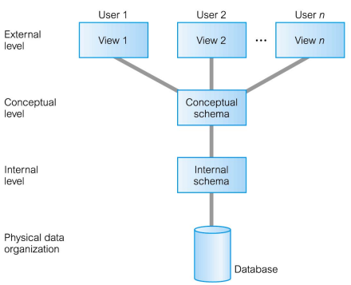
Three-Level Architecture
Notes:
American National Standards Institute (ANSI) and the Standards Planning and Requirements Committee (SPARC)

Slide 10
Purpose of Three-Level Architecture
Data Independence:
Allows changes at one level without affecting the others.
Flexibility:
Supports multiple views of the data for different users.
Abstraction:
Hides complex details of physical data storage from users and applications.
Consistency and Security:
Enables centralized control of data access and modifications.
Notes:
- External Schema: User-specific data views.
- Analogy: Library users see specific sections of books.
- Conceptual Schema: Unified logical view of the database.
- Analogy: Library catalog tracking all books and genres.
- Internal Schema: Details of physical storage.
- Analogy: Organization of books on shelves.

Slide 11
Levels of the Architecture
External Level (User View):
This is the highest level of abstraction.
This level describes that part of database that is relevant to a particular user.
Defines how users or applications interact with the database.
Each user can have a customized view of the database without being aware of the full schema.
Example:
An HR manager sees only employee records, while a finance team sees payroll data.
Notes:
American National Standards Institute (ANSI) and the Standards Planning and Requirements Committee (SPARC)

Slide 12
Levels of the Architecture
2. Conceptual Level (Logical View):
Represents the logical structure of the entire database.
Defines the data organization (e.g., entities, relationships) and constraints.
Ensures a unified logical representation that connects all user views.
Community view of the database. This level describes what data is stored in database and relationships among the data.
Example:
A relational schema with tables, columns, keys, and relationships.
Notes:
American National Standards Institute (ANSI) and the Standards Planning and Requirements Committee (SPARC)

Slide 13
Levels of the Architecture
3. Internal Level (Physical View):
The lowest level of abstraction.
Focuses on the physical storage of data (e.g., how data is stored on disk, indexing, file systems).
Ensures efficient storage, retrieval, and maintenance.
Describes how the data is stored in the database.
Example:
Data stored using B-trees or hash indexing.
Notes:
American National Standards Institute (ANSI) and the Standards Planning and Requirements Committee (SPARC)

Slide 14
Diagram: ANSI-SPARC Architecture
External Level: User-Specific Views
↕
Conceptual Level: Logical Schema (Unified View of Data)
↕
Internal Level: Physical Storage (File Systems, Indexing)
Notes:
American National Standards Institute (ANSI) and the Standards Planning and Requirements Committee (SPARC)

Slide 15
Example in Real Systems
E-Commerce:
External Level: Customers see product categories, while inventory managers see stock levels.
Conceptual Level: Defines relationships between products, orders, and customers.
Internal Level: Products and orders are stored physically with indexing for quick access.
Notes:
American National Standards Institute (ANSI) and the Standards Planning and Requirements Committee (SPARC)

Slide 16
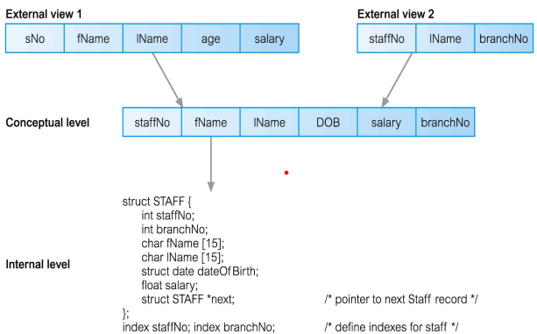
Differences between Three Levels of ANSI-SPARC Architecture
Notes:
American National Standards Institute (ANSI) and the Standards Planning and Requirements Committee (SPARC)

Slide 17
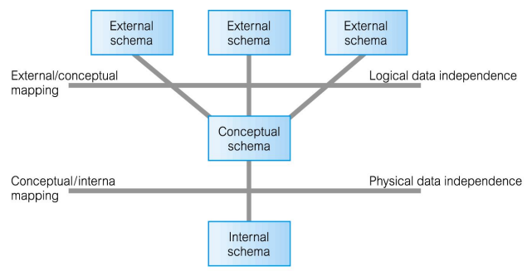
Data Independence and the ANSI-SPARC Three-Level Architecture

Slide 18
Data Independence and the ANSI-SPARC Three-Level Architecture
Data independence ensures that changes at one level of a database system do not affect higher levels.
Logical Data Independence
Logical data independence refers to the ability to change the conceptual schema without requiring changes to the external schemas or application programs.
This means modifications such as adding or removing entities, attributes, or relationships do not impact how users interact with the database.
For example, if a university database adds a new attribute for student email addresses, logical data independence ensures that existing applications retrieving student information remain unaffected.

Slide 19
Data Independence and the ANSI-SPARC Three-Level Architecture
Physical Data Independence
Physical data independence ensures that changes to the internal schema (how data is physically stored) do not affect the conceptual schema.
Changes such as using different storage structures, file organizations, indexing techniques, or new storage devices should not impact the way data is logically structured.
From a user’s perspective, the only noticeable change might be improved performance​.

Slide 20
Single-Tier, Two-Tier, and Three-Tier Architectures of Database Systems
Real-Life Analogy: Think of a restaurant:
Single-Tier: A food cart where the chef prepares and serves food directly to the customer.
Two-Tier: A restaurant where a waiter takes orders and directly communicates with the kitchen.
Three-Tier: A restaurant with a digital ordering system where waiters input orders into a system, which processes the request before sending it to the kitchen.

Slide 21
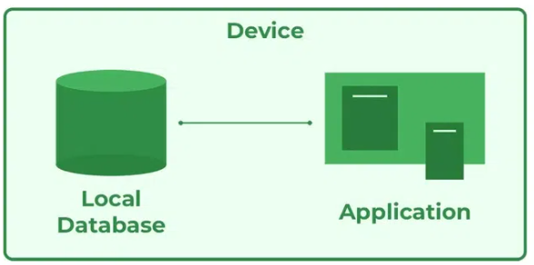
3-Tier / Database & Application Architecture
1. Single-Tier Architecture
In a single-tier architecture, the database and application reside on the same machine.
This structure is commonly used in standalone applications, where there is no network communication between different components.
Example: A personal finance management software installed on a user's laptop that manages all data locally.
Advantages:
Simple setup with no network dependency.
Faster data access as everything is on a single system.
Less complex management.
Disadvantages:
Not suitable for multi-user environments.
Limited scalability.
Poor security as everything is stored in one place.

Slide 22
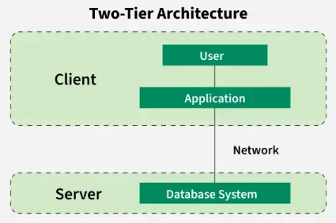
3-Tier / Database & Application Architecture
2. Two-Tier Architecture (Client-Server Model)
In a two-tier architecture, the system is divided into:
Client Tier (User Interface & Application Logic)
Database Server (DBMS & Data Storage)
The client directly communicates with the database server via SQL queries.
Example: A banking system where tellers use client applications to send SQL queries to a central database.
Advantages:
Improved performance by separating the application and database.
Centralized database management.
Supports multiple users.
Disadvantages:
Fat Client Problem: The client application requires significant resources (processing and memory).
Limited scalability as adding more clients increases server load.
Network congestion if too many queries are sent from multiple clients simultaneously​.

Slide 23
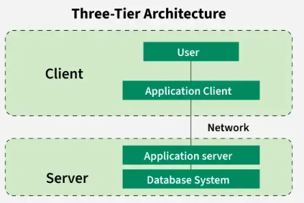
3-Tier / Database & Application Architecture
3. Three-Tier Architecture
The three-tier model improves upon the two-tier architecture by adding a middle tier (Application Server) between the client and database.
The system is divided into:
Presentation Layer (Client Interface) – Runs on user devices.
Application Layer (Business Logic & Processing) – Runs on an intermediate server, handling business logic and communicating with the database.
Database Layer (DBMS & Data Storage) – Stores and retrieves data.
Example: A web-based e-commerce platform where users access a web application, which in turn interacts with a database to retrieve product details.

Slide 24
3-Tier / Database & Application Architecture
Advantages:
Better Performance: The application server handles processing, reducing the load on the database.
Scalability: Additional application servers can be added to handle more users.
Improved Security: Users do not directly access the database; the application layer serves as a buffer.
Disadvantages:
Increased system complexity.
Higher infrastructure and maintenance costs.
Requires proper network and server management​.

